Slide 1
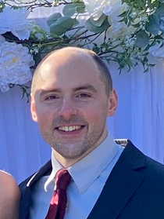


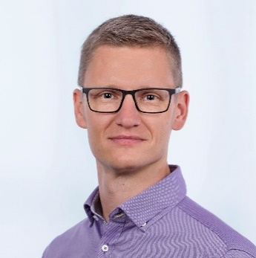


Variational Satisfiability Solving
Efficiently Solving Lots of Related SAT Problems
Empirical Software Engineering, 2022
Jeffrey M. Young
Paul Bittner
Eric Walkingshaw
Thomas Thüm

Slide 2
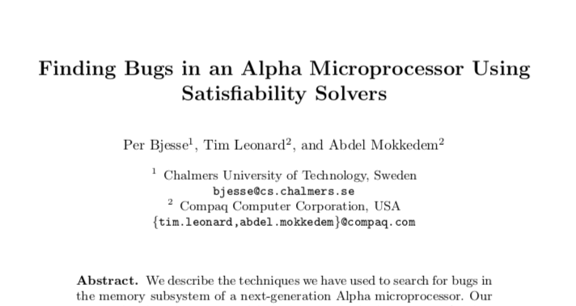
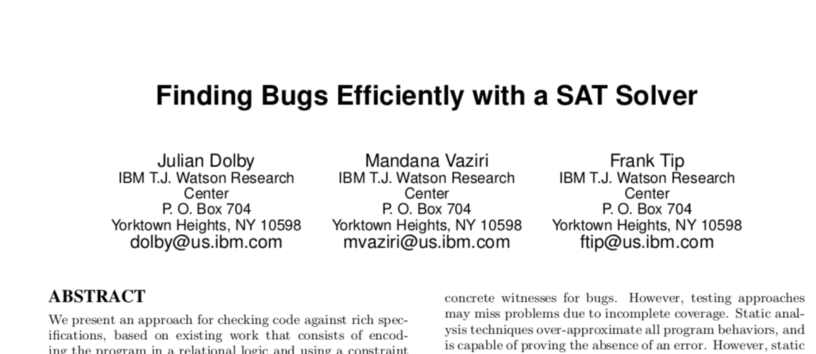
Impact
SAT solvers are ubiquitous
2
SAT solvers are used everywhere
Bug finding

Slide 3
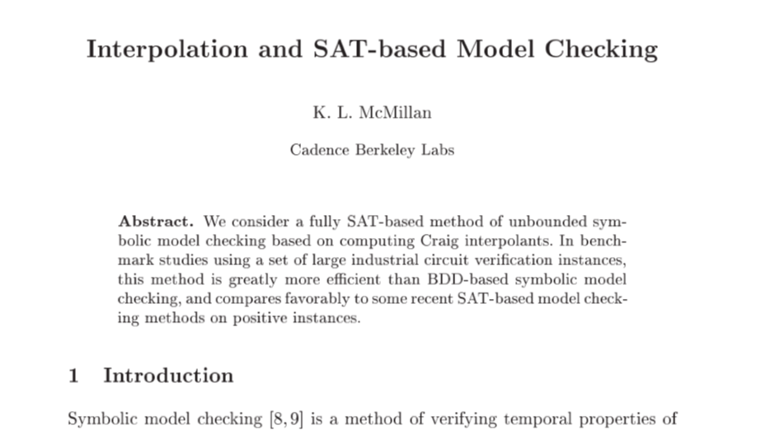
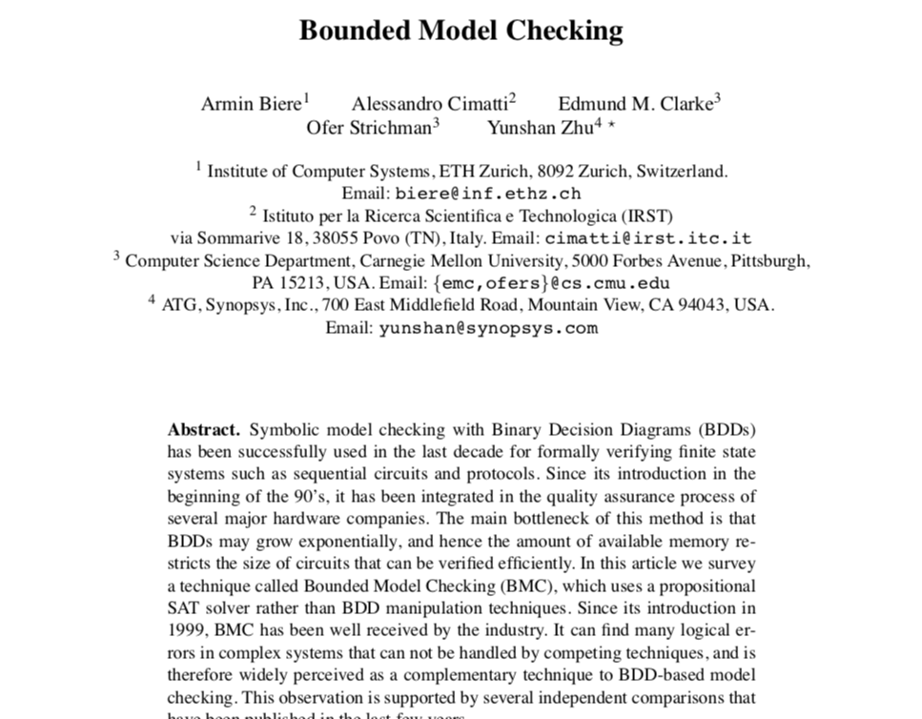

Impact
SAT solvers are ubiquitous
3
SAT solvers are used everywhere
Bug finding
Model checking

Slide 4

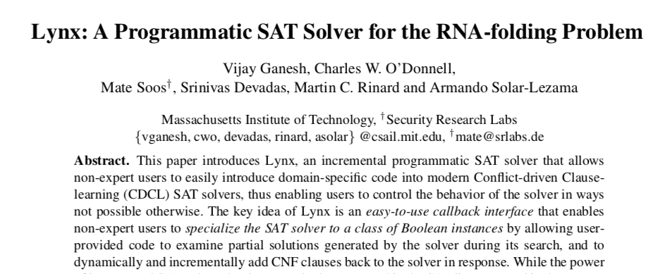

Impact
SAT solvers are ubiquitous
4
SAT solvers are used everywhere
Bug finding
Model checking
Bioinformatics

Slide 5
Impact
SAT solvers are ubiquitous
5
SAT solvers are used everywhere
Bug finding
Model checking
Bioinformatics
Scheduling
Software product-lines
Program Synthesis
Program Verification
Planning

Slide 6

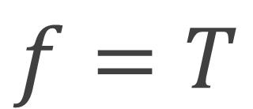
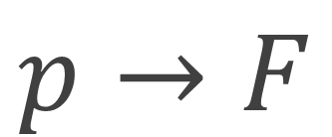
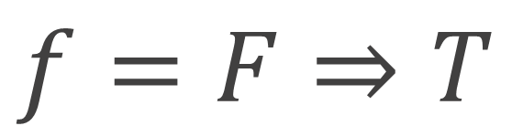
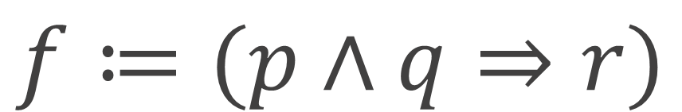
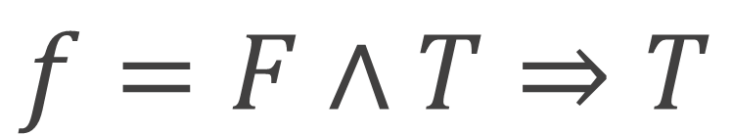
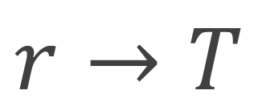
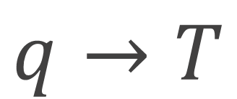
Background
What is a satisfiability solver?
6
A satisfiability (SAT) solver is a tool that solves the Boolean satisfiability problem
Given a formula in propositional logic:
$$f≔(p∧q⇒r)$$
Find an assignment such that f is satisfied:
$$p→F$$
$$f=F∧T⇒T$$
$$q→T$$
$$f=F⇒T$$
$$r→T$$
$$f=T$$

Slide 7




Problem
But how are SAT solvers used in practice?
7
Complicated system
Propositions
is satisfiable?
Interface
encode
SAT
solver
Track results
Marshaled results
{
This is great, however…
$$FM∧c_{1}∧c_{2}∧…∧c_{n}$$
When we want to solve sets of related
problems it is likely we are re-evaluating
several clauses or terms!
Propositions
$$FM∧c_{1}∧c_{10}∧…∧c_{n}$$
$$FM∧c_{10}∧c_{2}∧…∧c_{n}$$

Slide 8



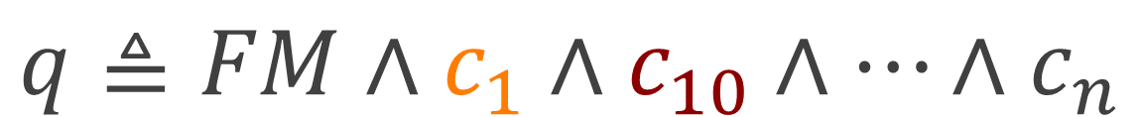
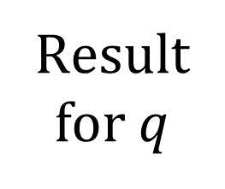



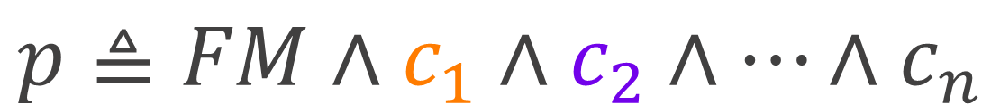








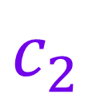


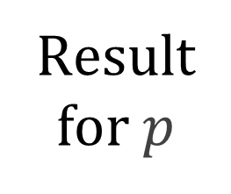
Background
Incremental satisfiability solving
8
Incremental SAT: Add or remove clauses to the assertion stack
Push: Add a clause
Pop: Remove the last clause
$$p≜FM∧c_{1}∧c_{2}∧…∧c_{n}$$
$$c_{10}$$
$$c_{10}$$
$$c_{1}$$
Result
for $q$
$$q≜FM∧c_{1}∧c_{10}∧…∧c_{n}$$
$$FM$$
$$\text{push}$$
$$FM$$
$$c_{1}$$
$$c_{2}$$
$$c_{2}$$
$$c_{1}$$
$$c_{1}$$
Result
for $p$
$$\text{push}$$
$$FM$$
$$\text{push}$$
$$FM$$
$$FM$$
$$\text{pop}$$
Directly addresses redundancy and is efficient
Een and Sörensson, An Extensible SAT-Solver 2003

Slide 9















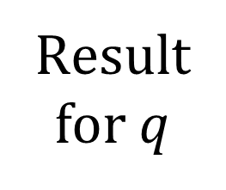





Problem
So just use incremental satisfiability solving?
9
$$c_{10}$$
$$c_{10}$$
$$c_{1}$$
Result
for $q$
$$FM$$
$$\text{push}$$
$$FM$$
$$c_{1}$$
$$c_{2}$$
$$c_{2}$$
$$c_{1}$$
$$c_{1}$$
Result
for $p$
$$\text{push}$$
$$FM$$
$$\text{push}$$
$$FM$$
$$FM$$
$$\text{pop}$$
But the solver is not aware of what is shared!
Push/pop do not denote meaning to the user
Hand-written program for each domain!

Slide 10




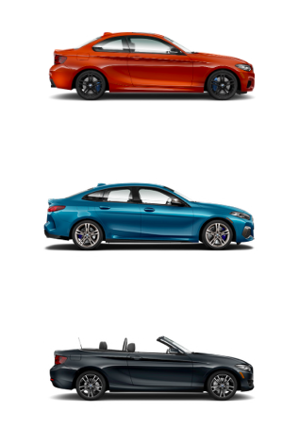


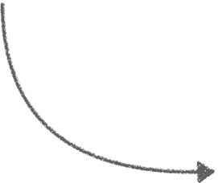



The Goal
Build a satisfiability solver that is variation-aware
10
What do we mean by variation?
That which can be configured to produce a variant
Variational Artifact
choose red
Variants
choose blue
All options have been chosen
choose gray
A variation-aware system is a system that operates on variational artifacts, not on variants.

Slide 11










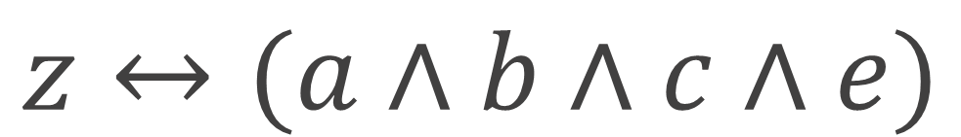
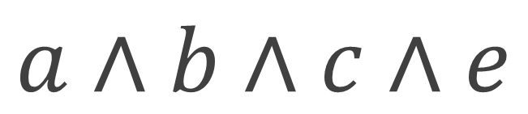
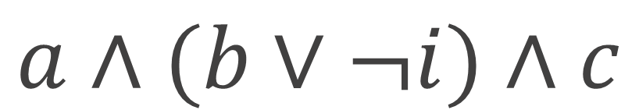
The Goal
Build a satisfiability solver that is variation-aware
11
Modern SAT solvers operate on variants
SAT solver that operates on a variational artifact
$$?$$
$$a∧b∧c∧e$$
$$a∧(b∨¬i)∧c$$
$$z↔(a∧b∧c∧e)$$

Slide 12
The Goal
Build a satisfiability solver that is variation-aware
12
Variational propositional logic
Variational model
Boolean propositions
Variational
solver
Encode
1. Define variational propositional logic
2. Develop a prototype variational SAT solver
3. Evaluate the solver on empirical data.
Show these ideas work in practice.

Slide 13



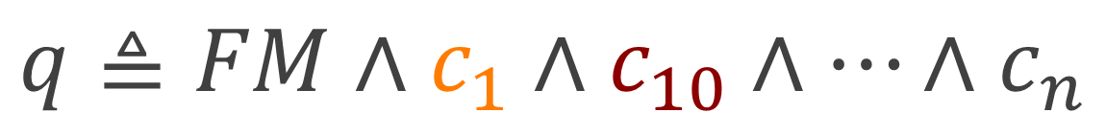
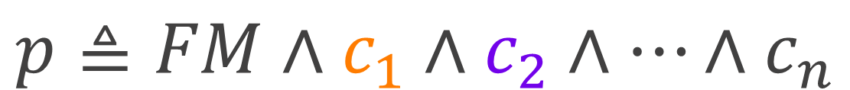
Contribution 1
Define variational propositional logic
VPL = Propositional Logic + Choice Calculus
$$p≜FM∧c_{1}∧c_{2}∧…∧c_{n}$$
$$q≜FM∧c_{1}∧c_{10}∧…∧c_{n}$$
New connective!
a Choice
$$p_or_q≜FM∧c_{1}∧A⟨c_{2},c_{10}⟩∧…∧c_{n}$$
With choices, shared terms are statically explicit!
The Choice Calculus: A Representation for Software Variation, Erwig and Walkingshaw, TOSEM 2011

Slide 14



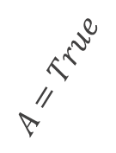

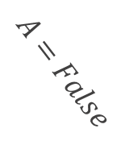

Contribution 1
Define variational propositional logic
Plain
Dimension
$$p_or_q≜FM∧c_{1}∧A⟨c_{2},c_{10}⟩∧…∧c_{n}$$
Left Alternative
Right Alternative
Configurations
$$A=False$$
$$A=True$$
Variants
$$FM∧c_{1}∧c_{2}∧…∧c_{n}$$
$$FM∧c_{1}∧c_{10}∧…∧c_{n}$$

Slide 15
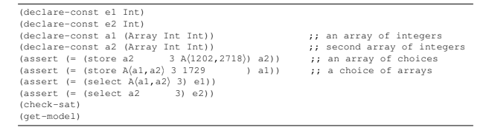
Contribution 2
A variation-aware SAT solving algorithm
This is a compiler
VPL
SMTLIB2
$$FM∧(c_{1}∨A⟨c_{2},c_{10}⟩∨¬(c_{i}∧c_{j}))$$
Goal:
Performance at least as good as a hand-written incremental program.

Slide 16
Contribution 2
A variation-aware SAT solving algorithm
Given a
VPL formula:
$$FM∧(c_{1}∨A⟨c_{2},c_{10}⟩∨¬(c_{i}∧c_{j}))$$
Strategy: Define a intermediate language, solve in 3 modes
Evaluation
Send terms to the solver if safe to do so
Accumulation
Cache and combine plain terms for future use
Choice Removal
Manipulate the configuration to remove choices

Slide 17
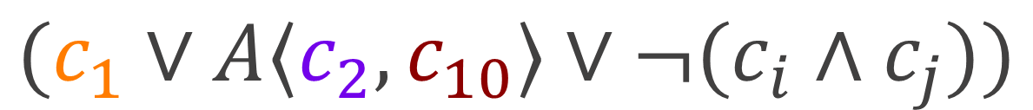

Contribution 2
Why 3 modes?
$$FM∧(c_{1}∨A⟨c_{2},c_{10}⟩∨¬(c_{i}∧c_{j}))$$
Evaluation
$$(c_{1}∨A⟨c_{2},c_{10}⟩∨¬(c_{i}∧c_{j}))$$
Accumulation
$$…∨A⟨c_{2},c_{10}⟩∨…$$
Choice Removal

Slide 18




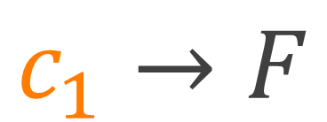












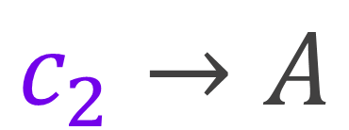
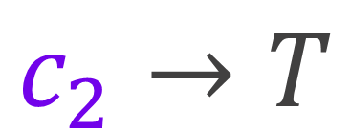
VSAT
Variational models
$$FM∧(c_{1}∨A⟨c_{2},c_{10}⟩∨¬(c_{i}∧c_{j}))$$
$${\text{Model}}_{A=True}$$
$${\text{Model}}_{A=False}$$
$$\text{Variational} \text{Model}$$
$$FM→T$$
$$FM→T$$
$$_Sat→A∨¬A$$
$$c_{1}→T$$
$$c_{1}→F$$
$$FM→A∨¬A$$
$$c_{1}→A$$
$$c_{2}→T$$
$$c_{10}→T$$
$$c_{10}→¬A$$
$$⋮$$
$$⋮$$
$$c_{2}→A$$
$$⋮$$

Slide 19
Thesis
Outline
Variational propositional logic
Variational model
Boolean propositions
Variational
solver
Encode
1. Define variational propositional logic
2. Develop a prototype variational SAT solver
3. Empirically evaluate the solver

Slide 20
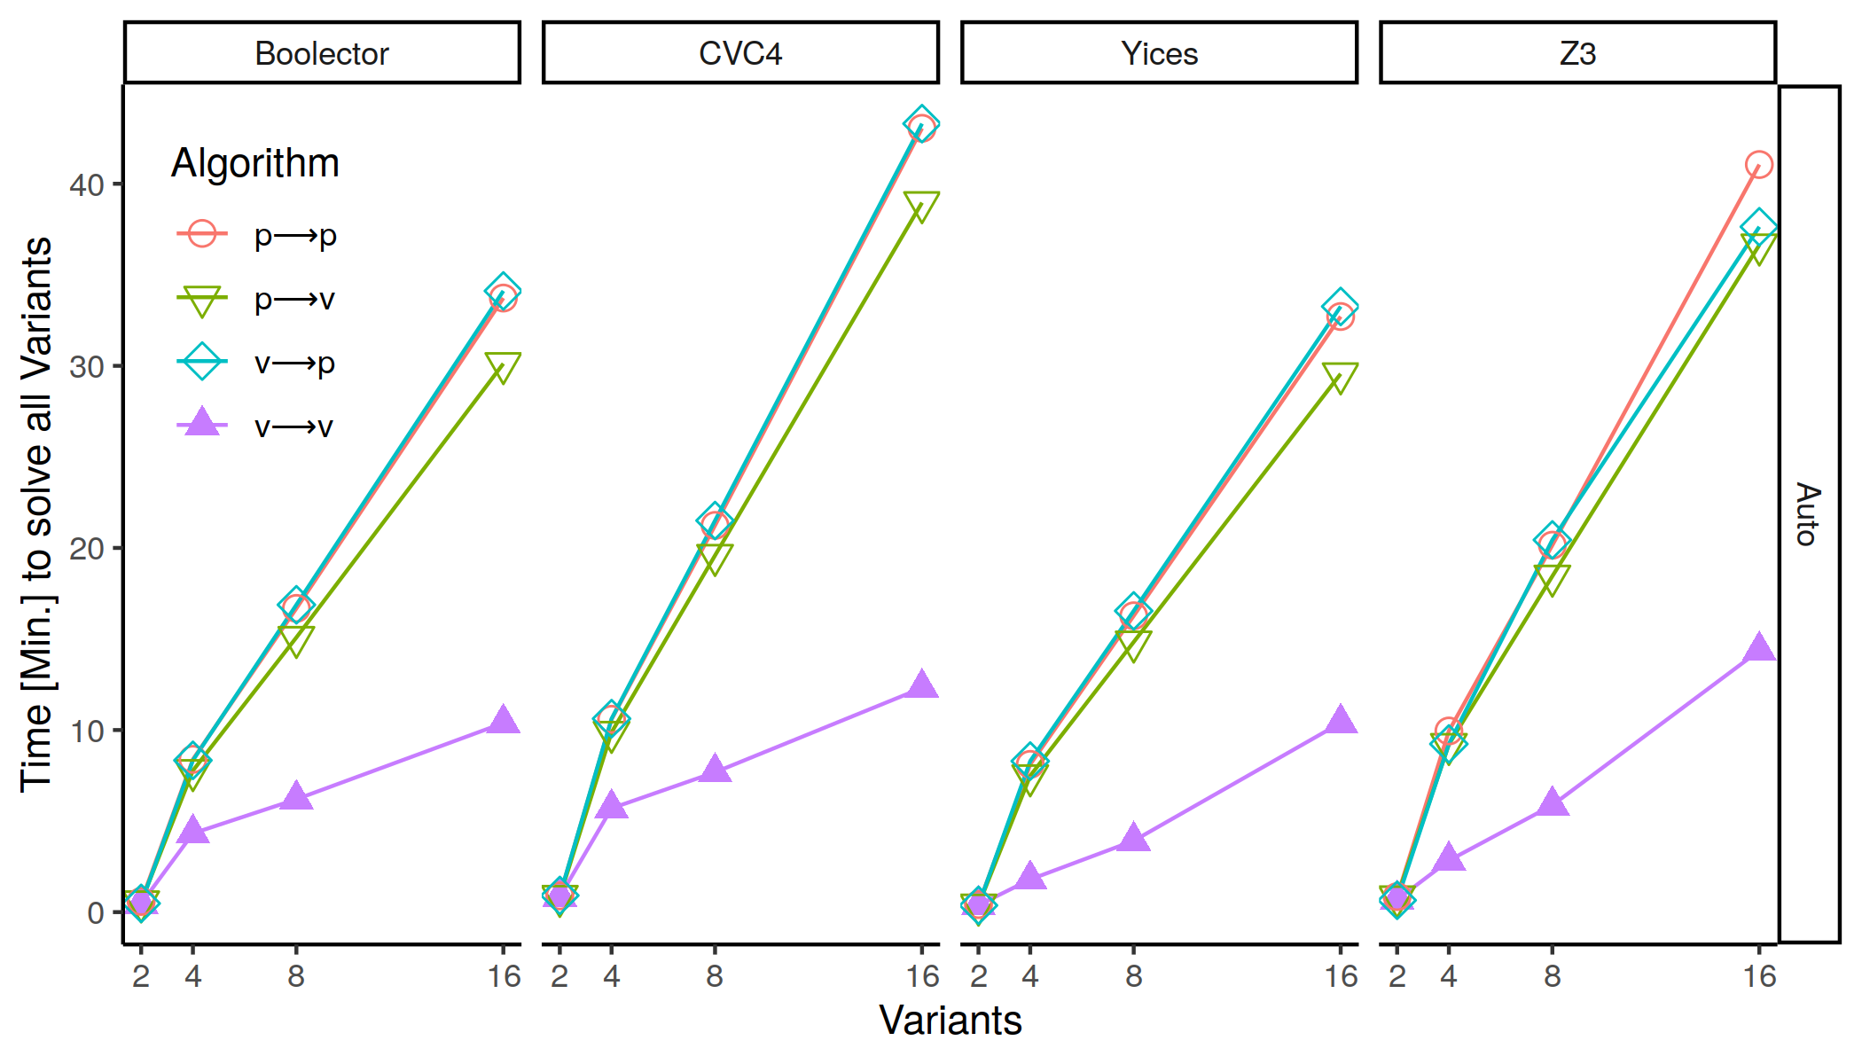
Contribution 4
RQ1: Performance by variants
 | Automotive02 | FinancialServices01
# unique dimensions choices | 4 | 10
# plain terms | 26,088 | 1,441
# choices | 4,212 | 3,809
Max. Obs. Speedup | 2.6-3.5x | 2.2-2.5x
*Datasets translated into VPL from Nieke et al, Anomaly Analyses for Feature-Model Evaluation

Slide 21
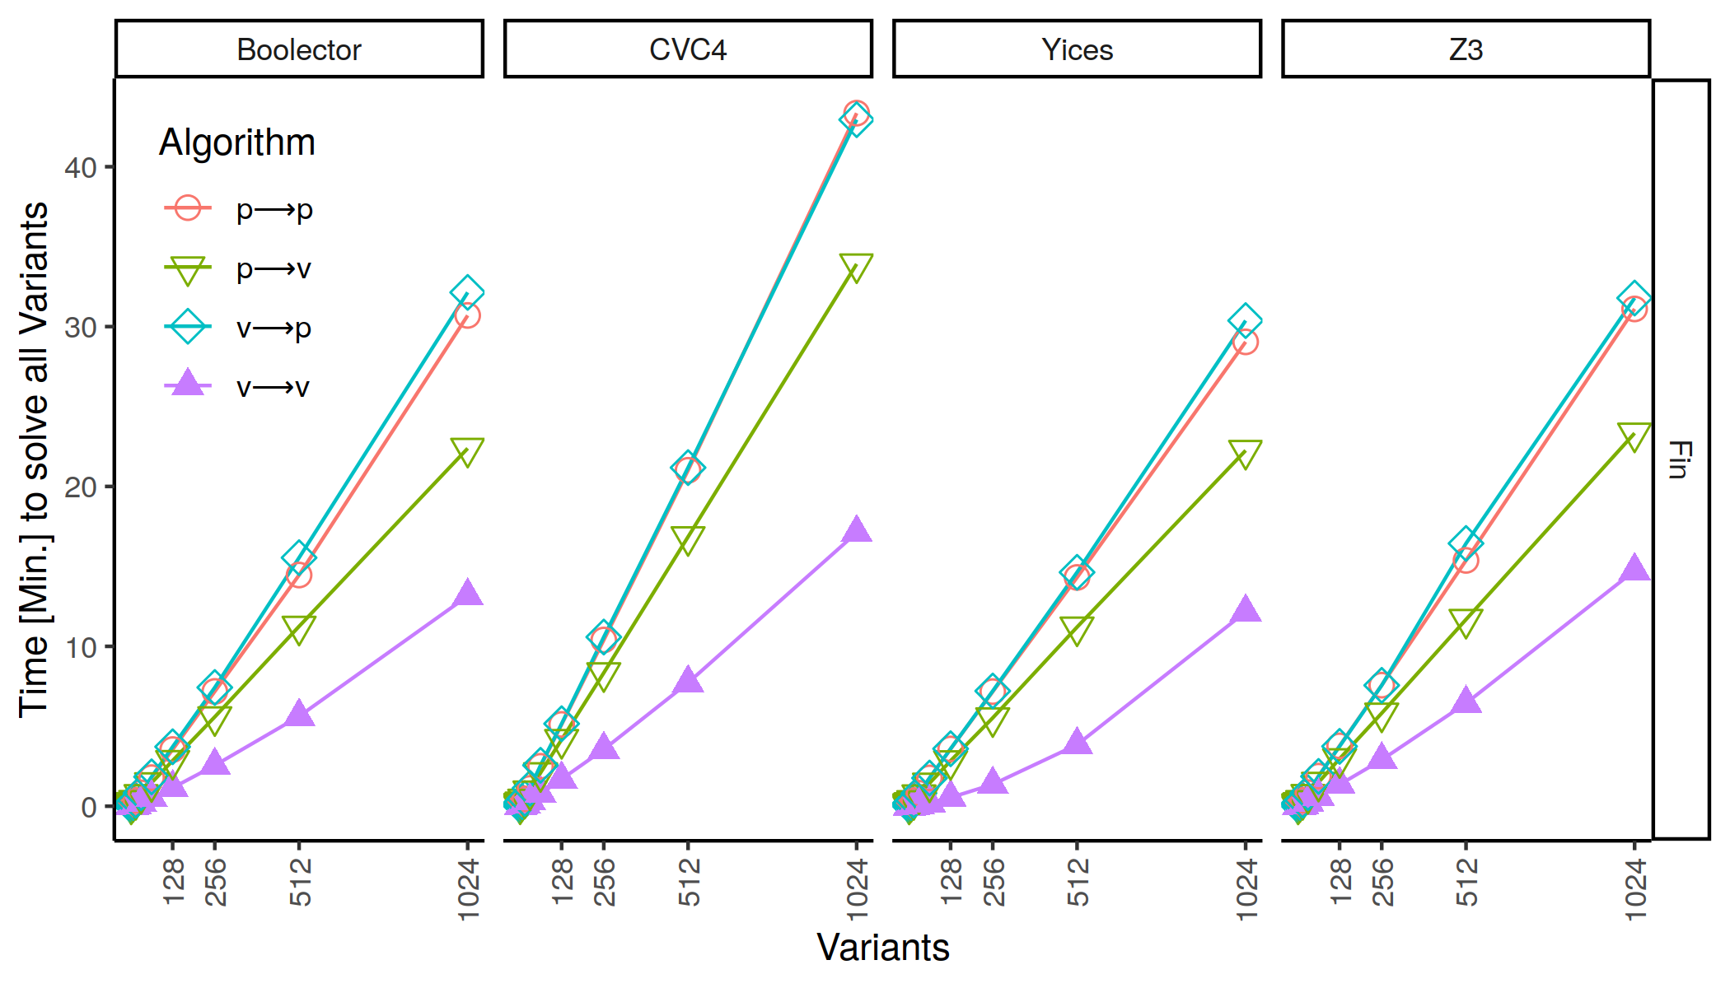
Contribution 4
RQ1: Performance by variants

Slide 22
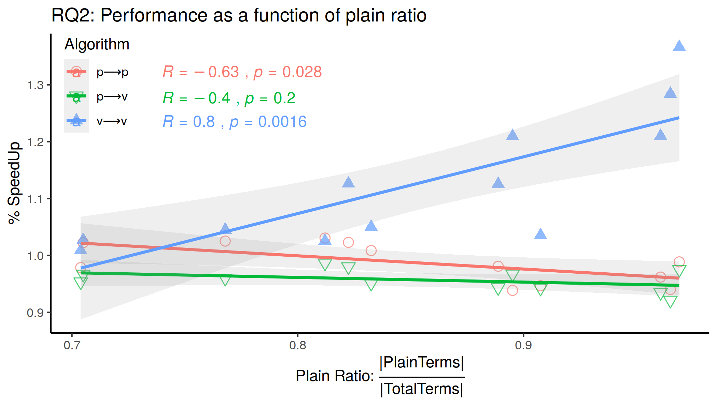
Contribution 4
RQ2: Impact of sharing on performance
Plain ratio of a VPL formula is positively correlated to performance

Slide 23
Variational Satisfiability Solving – Efficiently Solving Lots of Related SAT Problems
Variational propositional logic
Variational model
Boolean propositions
Variational
solver
Encode
Frequent need to solve many related satisfiability problems.
Our solution: variational satisfiability solving.
Must know all points of variation before solving.
Sharing impacts performance.

Slide 24
Variational Satisfiability Solving
Efficiently Solving Lots of Related SAT Problems
Empirical Software Engineering, 2022
Jeffrey M. Young
Paul Bittner
Eric Walkingshaw
Thomas Thüm

Slide 25
Backup
Backup

Slide 26

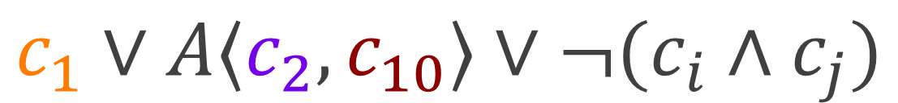
VSAT
Evaluation
VPL Formula:
$$FM∧(c_{1}∨A⟨c_{2},c_{10}⟩∨¬(c_{i}∧c_{j}))$$
Evaluation
$$FM∧(c_{1}∨A⟨c_{2},c_{10}⟩∨¬(c_{i}∧c_{j}))$$
$$∙∧(c_{1}∨A⟨c_{2},c_{10}⟩∨¬(c_{i}∧c_{j}))$$
$$c_{1}∨A⟨c_{2},c_{10}⟩∨¬(c_{i}∧c_{j})$$
$$FM$$

Slide 27







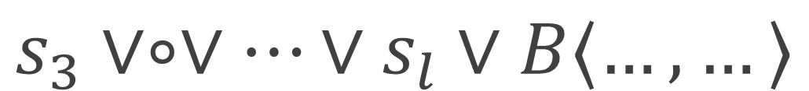
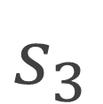
VSAT
Choice Removal: Zippers
Zipper = Focus + Context
General case:
$$s_{3}∨A⟨c_{2},c_{10}⟩∨…∨s_{l}∨B⟨…,…⟩$$
Focus:
Context:
$$s_{3}$$
$$∘∨A⟨c_{2},c_{10}⟩∨…∨s_{l}∨B⟨…,…⟩$$
The Focus is a hole!
$$A⟨c_{2},c_{10}⟩$$
$$s_{3}∨∘∨…∨s_{l}∨B⟨…,…⟩$$
See “The Zipper” function pearl, Huet 1997

Slide 28






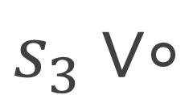
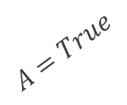
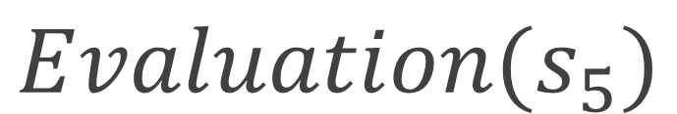

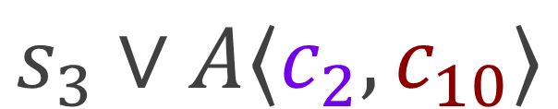
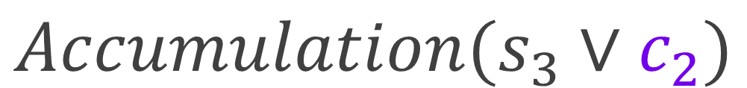
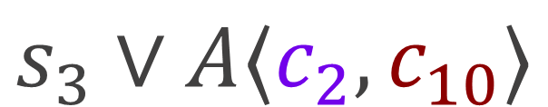


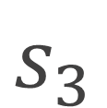
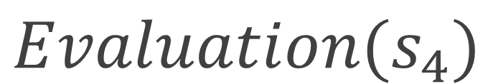

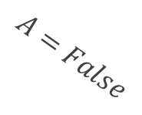

VSAT
Choice Removal
Variational core:
$$s_{3}∨A⟨c_{2},c_{10}⟩$$
Choice Removal
In Focus
$$s_{3}∨A⟨c_{2},c_{10}⟩$$
$$s_{3}$$
$$∘∨A⟨c_{2},c_{10}⟩$$
$$s_{3}∨∘$$
$$A⟨c_{2},c_{10}⟩$$
$$A=True$$
$$A=False$$
$$\text{push}$$
$$Accumulation(s_{3}∨c_{2})$$
$$Accumulation(s_{3}∨c_{10})$$
Model
$$Evaluation(s_{4})$$
$$Evaluation(s_{5})$$
$$\text{pop}$$

Slide 29
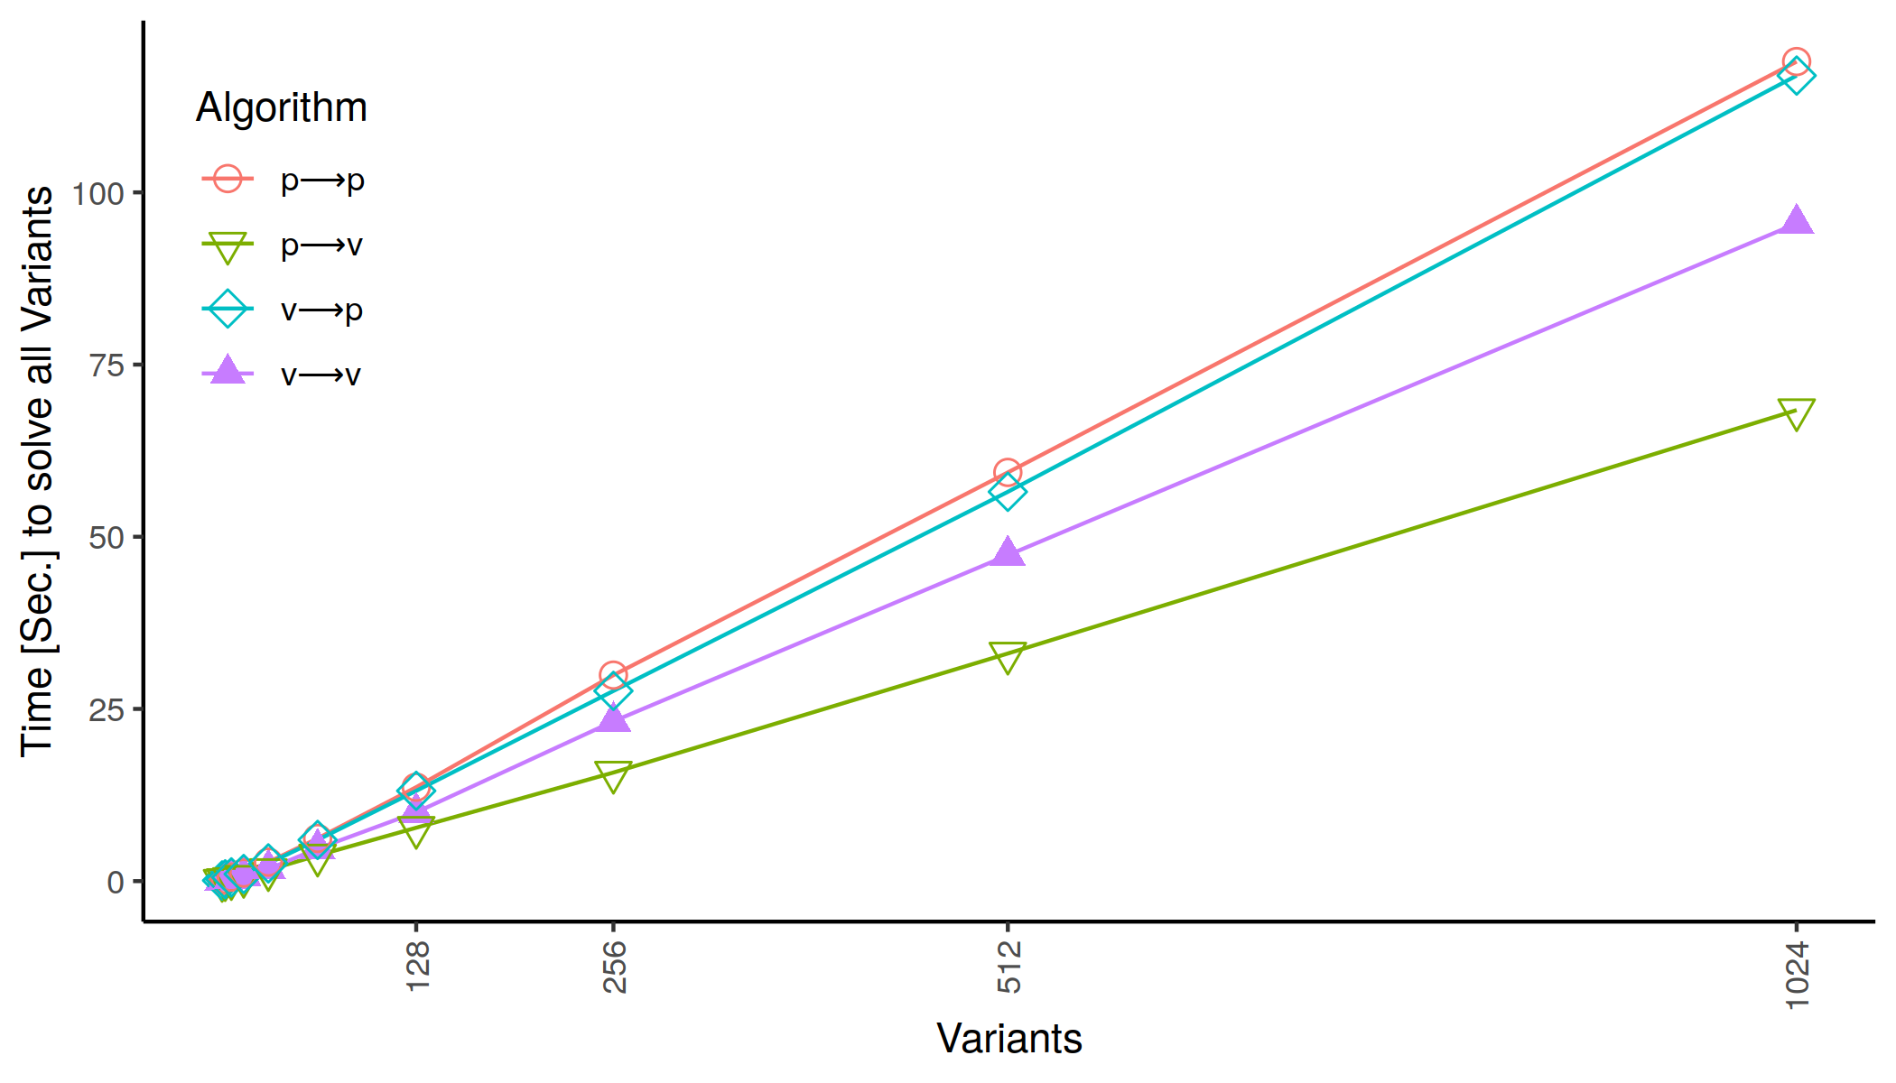
Contribution 4
Performance for VSMT solver

Slide 30

Contribution 4
Performance for Different Underlying SAT Solvers
Prototype Solver does not show significant overhead for both datasets

